Slide 1
AMBLYOPIA 2018
LIONEL KOWAL
MELBOURNE

Slide 2
TODAY……
Aimed at the optometrist who:
Already sees some kids
Knows how difficult it is :
… to get a reliable acuity
… a reliable objective refraction
… a fundus exam
... to persuade parents to apply treatments that the child doesn’t want to cooperate with

Slide 3
Where have we come from…
The 17th century
Late 19th century
Erasmus Darwin [Charles Darwin’s grandfather], ophthalmologist, introduces occlusion therapy for amblyopia
First recorded case of over-treatment of amblyopia with atropine causing occlusion amblyopia

Slide 4
Where are we heading…
The end of the 20th century
The start of the 21st century
PEDIG / MOTAS amblyopia treatment dosage studies: sorting out the best way[s] to use these ancient treatments
Hi – tech Binocular treatments
Hi - tech tests / measurements

Slide 5
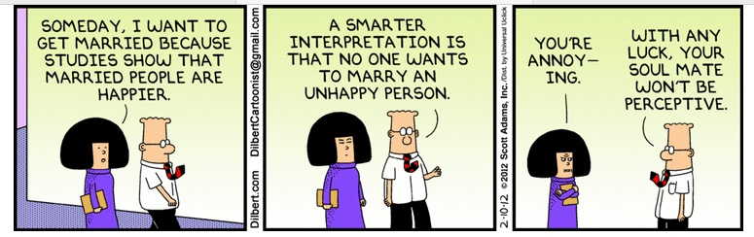
Is it perfume or is it tea?
A song about Earl Gray tea
‘TRUTH’ CAN BE FLEXIBLE UNTIL YOU FIND IT
SELECTION BIAS :
AN UN/UNDER- RECOGNISED PROBLEM
IN MUCH AMBLYOPIA RESEARCH

Slide 6
IT’S ALL CALLED AMBLYOPIA
BUT IT’S NOT ALL THE SAME - IT’S ALL DIFFERENT
‘EASY’ AMBLYOPIA
DIFFICULT AMBLYOPIA
Responds to glasses after 2-3 months. Regains stereo.6/6 outcome
Responds to glasses & 1-2 cycles [1 week per year of age] of occlusion [or weekend atropine]. Regains good stereo. 6/9+ outcome
Amblyopia. Large constant strab. Patch /atropine ineffective or not tolerated. Aligned with surgery. Patch / atropine now more effective. 6/12 outcome.
a/a…..6/30 outcome
a/a …2-3 surgeries needed
With high anisometropia…6/12 outcome
a/a….6/30 outcome

Slide 7
OVERVIEW
DETECTION inc examination techniques
ASSOCIATED FINDINGS
TREATMENTS

Slide 8
DETECTION inc examination techniques
Only acuity?
Which chart[s]?
Contrast?..which tests
P-Robson, 3 cpm*, 10%*, Vistech
Grating? Sweep VEP?
Pediatric Vision Scanner
*Thank you Jos Verbaken for enthusing me with your charts

Slide 9
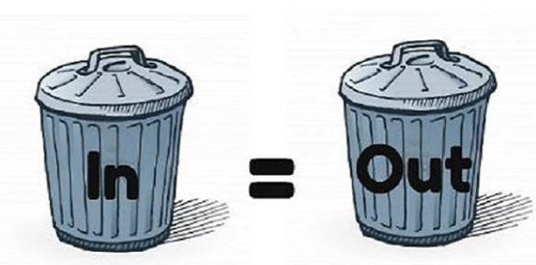
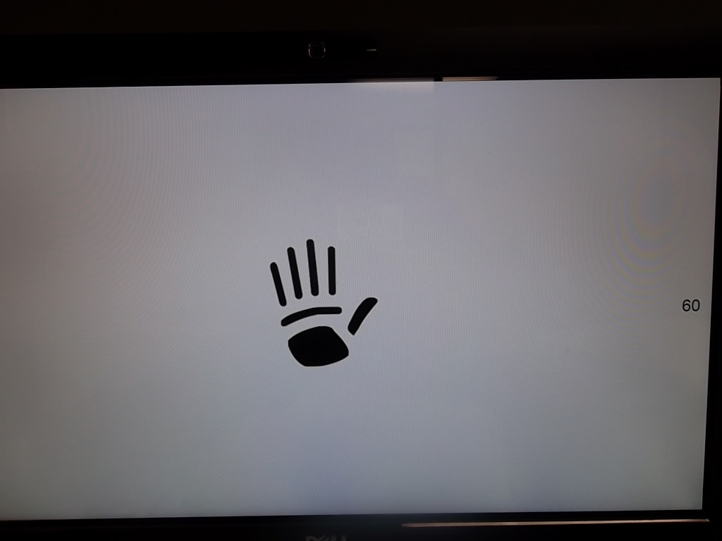
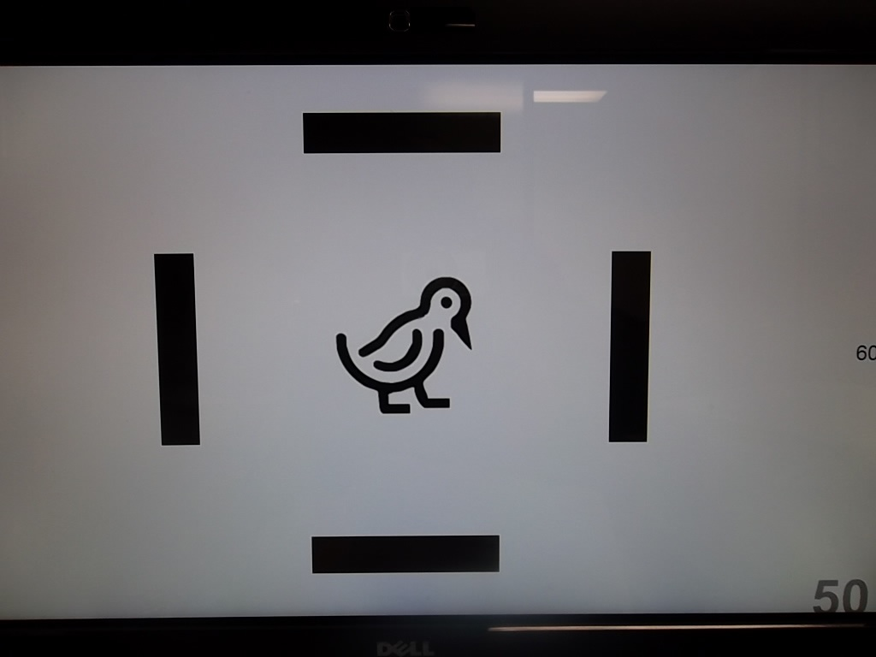
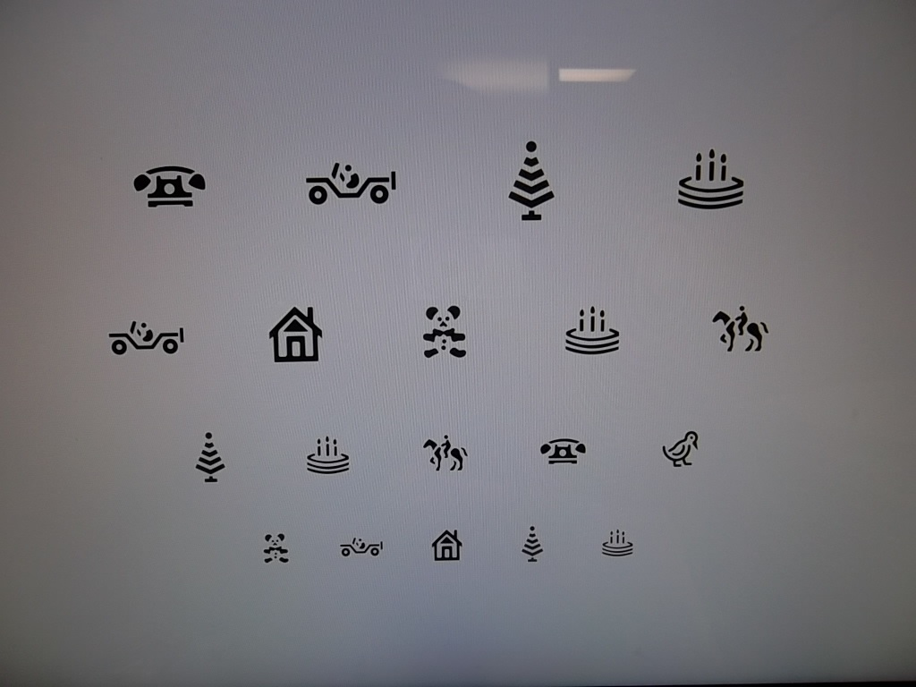
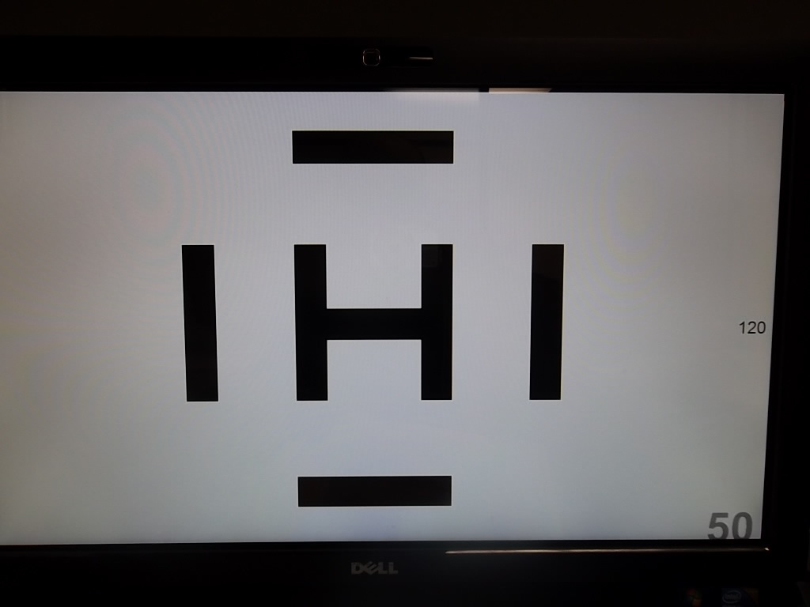
Problems in collecting data [old]
Chart
Kay’s, Allen pix ± interaction bars
Lea. Distance, near (measured 40cm).
Lines or singles ± interaction bars
Letters – Snellen, ETDRS* / NVRI [near], HOTV *
Lines or singles ± interaction bars
Computerised charts:
Medmont, M&S*, Vistavision, ….
* PEDIG approved : you should NOT use other charts

Slide 10
LK recommendations –
EBM Evidence Based Medicine & GHBM Grey Hair Based
1. All kids are tested by orthoptist O1 and then by ophthalmologist O2
2 different / similar tests by 2 different people in 2 different rooms
2. Usual O1 tests : Lea D&N, NVRI letters [rows of 5], NVRI near [down to N2].
Other: Kay’s, projected gratings [retinometer]
3. Usual O2 tests : Allen pix, Lea D, ETDRS / NVRI letters [all: singles ± interaction bars]
Others: HOTV [singles ± interaction bars]; whole lines Allen, ETDRS, Lea

Slide 11
LK: Common findings 1
O1 gets ‘better’ results than O2 - fresher
O2 gets ‘better’ results than O1 – learning experience
N better than D – easier to do / understand
N worse than D – typical of amblyopia, and this improves first
Usually record ALL results – may have Best & Worst of the day

Slide 12
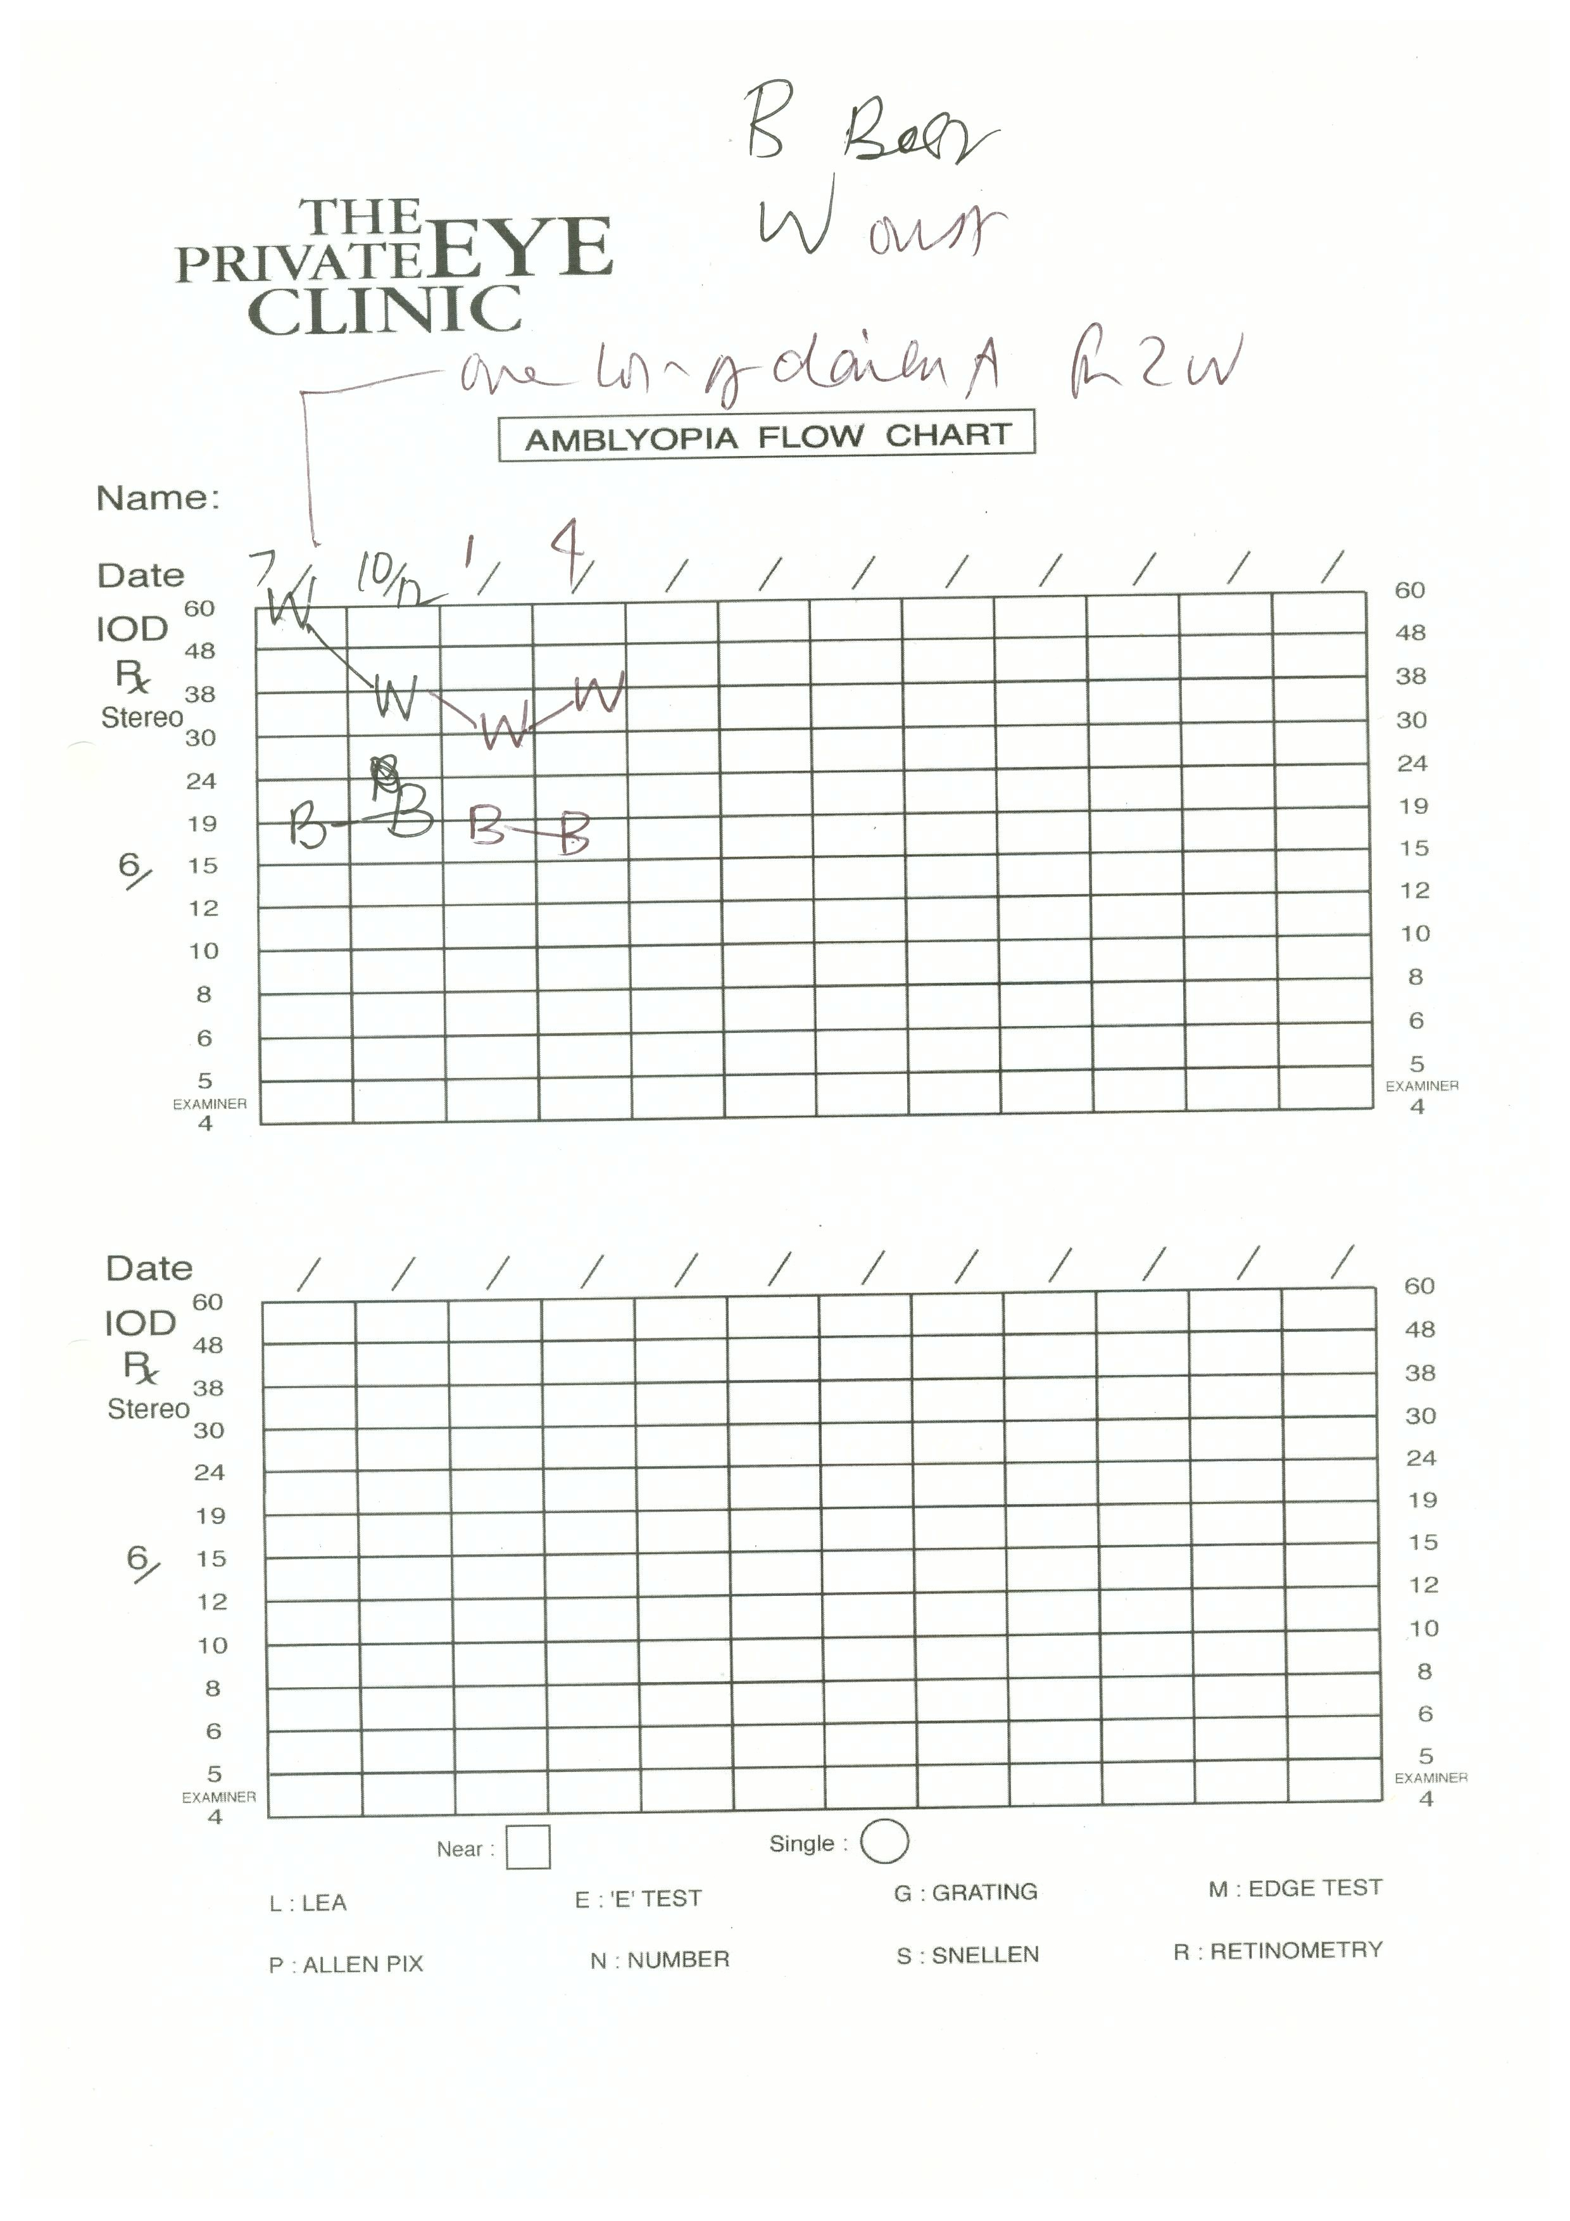
GETTING NOWHERE FAST/ SLOWLY

Slide 13
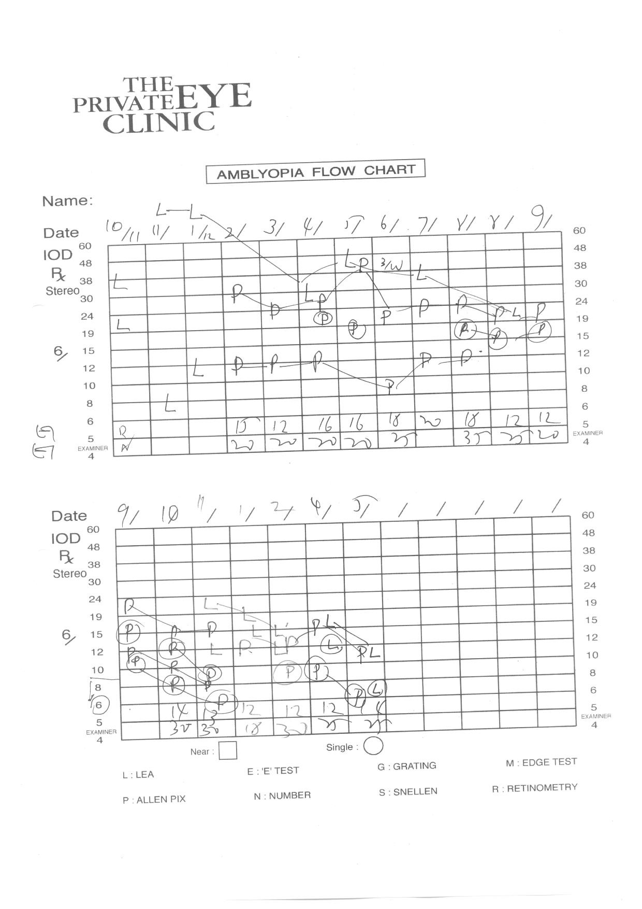
GOOD EYE ABOVE
THRESHOLD:
ALL RESULTS A BIT
SUSPECT
INTEROCULAR
DIFFERENCE GETS
LESS & LESS=GOOD
‘GOOD’ EYE BETTER:
ALL RESULTS NOW
MORE RELIABLE

Slide 14
OVERVIEW
DETECTION inc examination techniques
Only acuity?
Which chart[s]?
Contrast?..which tests P-Robson, 3 cpm*, 10%*, Vistech?
Grating? Sweep VEP?
Pediatric Vision Scanner
*Thank you Jos Verbaken for enthusing me with your charts

Slide 15

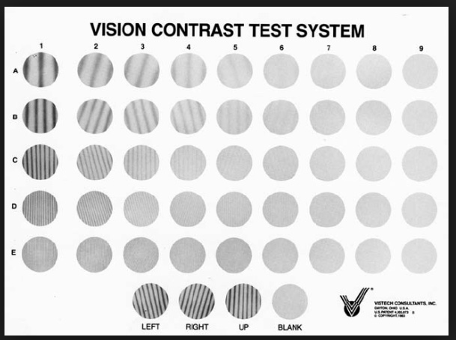
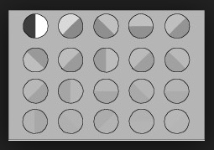
Contrast?..which tests P-Robson, 3 cpm, 10%, Vistech?
Late 1980’s: Vistech : low frequency acuity [eg Melbourne Edge Test] improves before high frequency [regular] acuity: MAKING A COMEBACK…..a core feature of many binocular treatments of amblyopia

Slide 16
Contrast testing in amblyopia
Resurgence of interest in contrast defects in amblyopia with new Binocular Treatments of amblyopia
‘Assessing binocular interaction in amblyopia and its clinical feasibility’
Kwon…Hunter.. [Boston] PLoS One June 2014
Contrast in amblyopic typically only 20%
of ‘normal’ eye - a useful parameter

Slide 17
Pediatric Vision Scanner
Previous screeners aimed to detect risk factors for strabismus / amblyopia
PVS is the first screener that detects amblyopia and strabismus directly
Looking for investors to take it to market

Slide 18
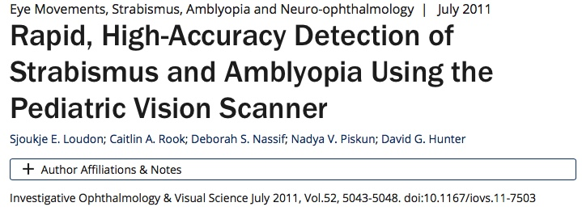
Pediatric Vision Scanner
Boston Children’s & Johns Hopkins
Looks @ the birefringence pattern of the orientation of the [Henle] nerve fibre layer around the macula

Slide 19
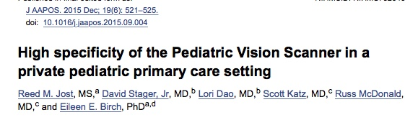
Pediatric Vision Scanner

Slide 20
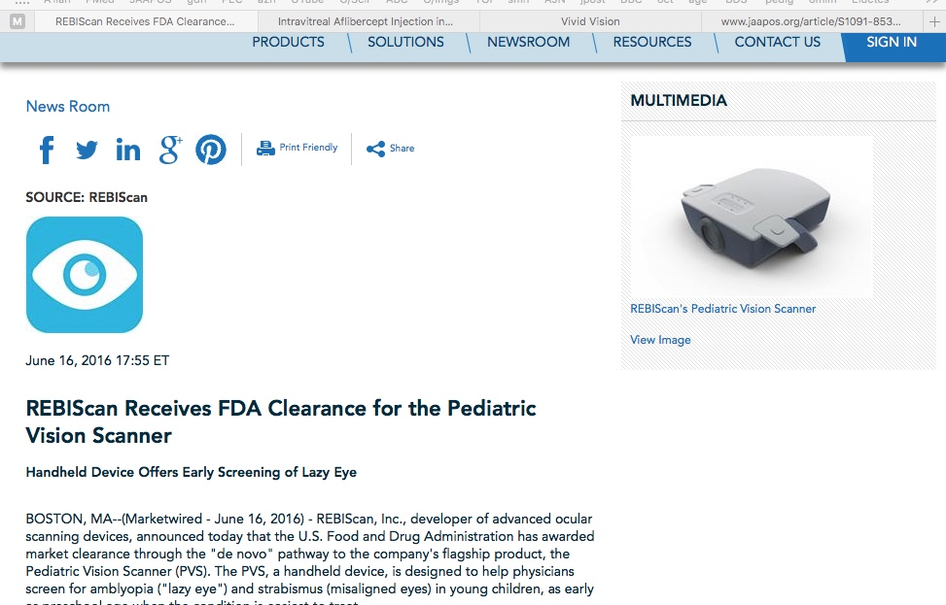
Pediatric Vision Scanner

Slide 21
OVERVIEW
DETECTION inc examination techniques
ASSOCIATED FINDINGS
TREATMENTS

Slide 22
OVERVIEW:
7 ASSOCIATED FINDINGS
Abnormal macular / submacular choroidal thickness on OCT
Optic disc dysversion
Optic nerve hypoplasia
Gaze instability
Fine motor skill deficits
Abn saccades [initiation & execution}
Reduced maximum reading speed
…..have all been described in subsets of patients with amblyopia.

Slide 23
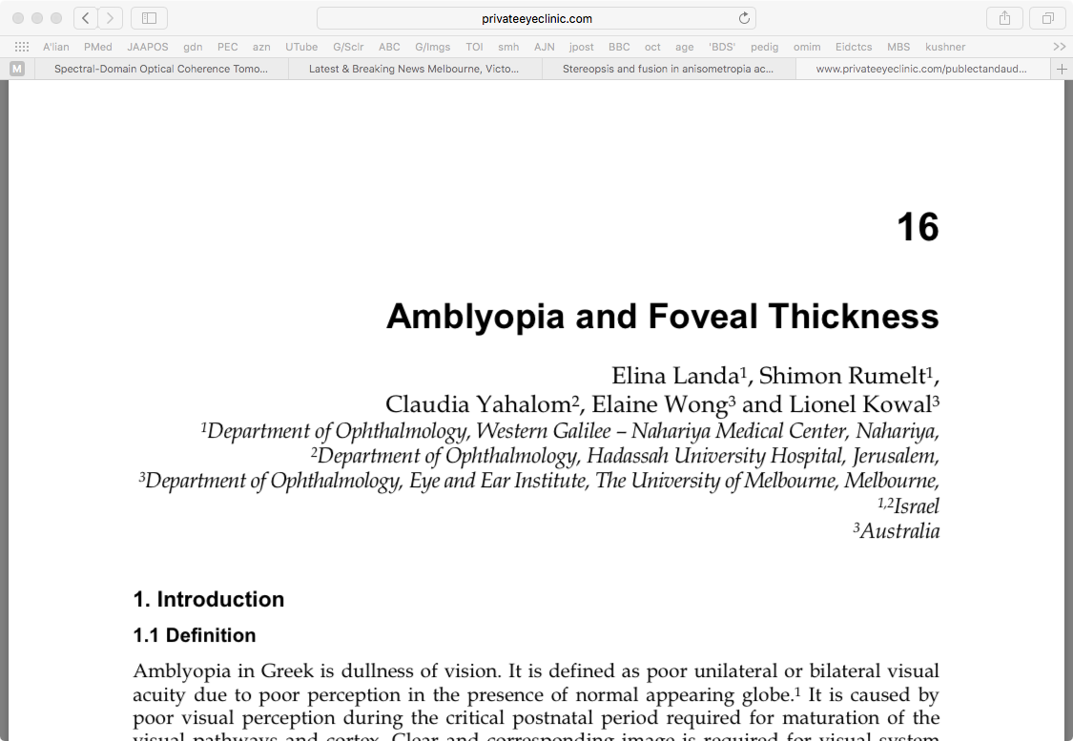
ASSOCIATED FINDINGS 1

Slide 24
Amblyopia and Foveal Thickness 1
Landa, Rumelt, Yahalom, Wong & Kowal 2012
The foveal thickness in amblyopic eyes was 201±42 μm …. and in the normal fellow eyes 174±27 μm.
The fovea was statistically thicker in the amblyopic eyes of whatever cause than in the normal fellow eye (p=0.011).
The foveal thickness in eyes with anisometropic amblyopia (n=10) was 194±45 μm and in the fellow eyes of the same patients 167±23 μm (p=0.059).
The foveal thickness in eyes with strabismic amblyopia (n=9) was 210±39 μm and in the fellow eyes of the same patients 181± 30 μm (p=0.070).

Slide 25
Amblyopia and Foveal Thickness 2
Landa, Rumelt, Yahalom, Wong & Kowal 2012
8/19 (42%) patients experienced improvement in BCVA after occlusion.
10/19: anisometropia. 6/10 improved acuity with occlusion.
9/19 strabismus: 2/9 improved acuity with occlusion.
The foveal thickness in the patients who showed no improvement in BCVA after treatment was 216±41 μm , fellow eyes 176±31 μm (p=0.016).
In those who showed improvement, the foveal thickness in the amblyopic eyes was 181±36 μm , fellow eyes 171±21 μm
SUGGESTION: the subgroup of [mostly anisometropic] amblyopes that had thicker foveas did less well with amblyopia Rx

Slide 26
OVERVIEW: ASSOCIATED FINDINGS
Abnormal macular thickness
Bayhan et al
Effect of amblyopia treatment on choroidal thickness in children with anisohyperopic amblyopia
Curr Eye Res Sept 2017
Subfoveal choroidal thickness abnormalities partly regress with treatment

Slide 27
OVERVIEW: ASSOCIATED FINDINGS
Abnormal macular thickness
Comez et alii
Retina & optic disc characteristics in amblyopic & non-amblyopic eyes with aniso- hyperopia / -myopia
Turk J Ophthalmol Jan 2017
No significant abnormality of RNFL, macula or disc

Slide 28
OVERVIEW: ASSOCIATED FINDINGS
Abnormal macular thickness
Chen et alii
Thickness of retinal layers … anisometropic amblyopia
PLoS One March 2017
SD-OCT ..marginal differences in some foveal layers at peripheral locations.. differences scattered .. represented no identifiable pattern

Slide 29
OVERVIEW: ASSOCIATED FINDINGS
Abnormal macular thickness
Singh et alii
Measurements of peripapillary RNFL thickness and macular thickness…
Clin Ophthal Feb 2017
No significant difference in central macular thickness & peripapillary RNFL thickness … inf quadrant RNFL thicker in anisohyperopia

Slide 30
OVERVIEW: ASSOCIATED FINDINGS
Abnormal macular thickness
Liu et alii
Meta analysis of choroidal thickness…
J Ophthal 2017
Increased subfoveal choroidal thickness in amblyopic eyes

Slide 31
OVERVIEW: ASSOCIATED FINDINGS
Abnormal macular thickness
Kasem et al
Changes in macular parameters…
Clin Ophthal Aug 2017
Amblyopic eyes higher Central Macular Thickness, thicker global RNFL.
Different types of amblyopia had different variations in retinal measurements

Slide 32
OVERVIEW: ASSOCIATED FINDINGS
Abnormal macular thickness
Araki et alii
Macular retinal & choroidal thickness…
BMC Ophthalmol Sept 2017
Hyperopic anisometropic amblyopia…
No difference in inner retinal thickness.
Siginficant differences in choroidal thickness with anisohyperopic amblyopia [?algorithm bias/error], not with strabismic amblyopia

Slide 33
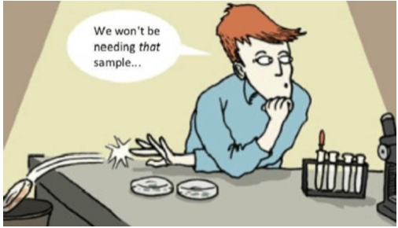
All these OCT in amblyopia studies: What do they all mean?
OCT doesn’t prove anything +ve or –ve in amblyopia
Unrecognised selection bias
Unrecognised OCT algorithm errors

Slide 34
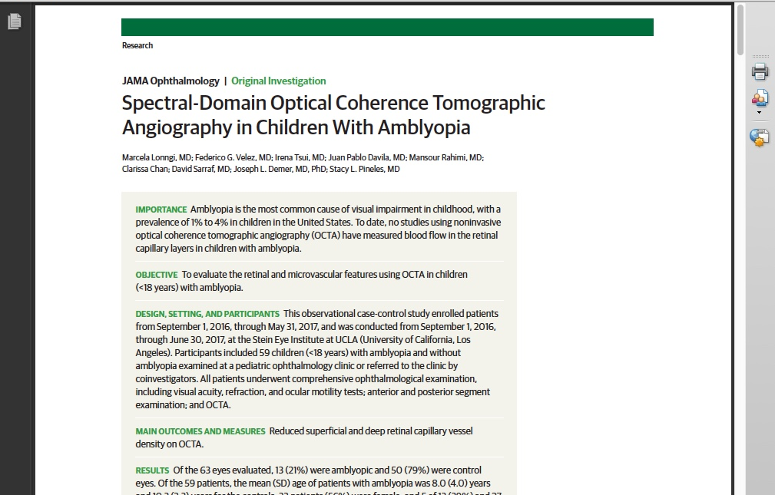
The next steps in sampling error, algorithm error or selection bias?
JAMA Ophthal
Sept 2017

Slide 35
OVERVIEW:
7 ASSOCIATED FINDINGS
Abnormal macular / submacular choroidal thickness
Optic disc dysversion
Optic nerve hypoplasia
Gaze instability
Fine motor skill deficits
Abn saccades [initiation & execution}
Reduced maximum reading speed
…..have all been described in subsets of patients with amblyopia.

Slide 36
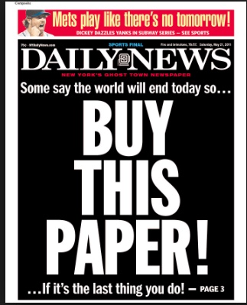
ASSOCIATED FINDINGS:
STUBBORN AMBLYOPIA 1
Birch / Progress in Retinal and Eye Research 33 (2013) P.71
26 children with persistent residual strabismic, anisometropic, or combined mechanism amblyopia
Compared retina, optic nerve, and gaze control characteristics of amblyopic eyes with fellow eyes, with age-matched nonamblyopic children who had strabismus or anisometropia, & with age-matched normal controls.
All amblyopic children had been treated with glasses, patching, &/or atropine for 0.8-5 years, had residual acuity deficit, & no improvement in acuity despite treatment and excellent compliance for > 6 mo

Slide 37
ASSOCIATED FINDINGS: STUBBORN AMBLYOPIA 2
Birch / Progress in Retinal and Eye Research 33 (2013) P.71
Macula was imaged:
with the Spectralis (SD-OCT) using eye-tracking feature (ART).
Total macular thickness and sectional volumes were automatically
determined by Heidelberg software using a modified ETDRS circle grid
Disc was imaged:
1-3 line scans centered on disc to measure horizontal and vertical disc diameter
1-3 mm high-resolution peripapillary RNFL circular scans, &
1-3 high-resolution macular volume scans.
Optic disc dysversion (tilt) was quantified by calculating the ratio of vertical to horizontal disc diameters.
Optic nerve hypoplasia quantified by calculating the area of the ellipse specified
by the vertical and horizontal diameters.
?sectoral hypoplasia: RNFL thickness automatically segmented using the Spectralis software (average thickness measurements for the 6 RNFL sectors centered on the disc)
HIGHEST – TECH IMAGING POSSIBLE

Slide 38
ASSOCIATED FINDINGS:
STUBBORN AMBLYOPIA 3
E.E. Birch (2013)
Gaze control
Infrared eye tracker during attempted steady fixation in primary position: these were the ONLY abnormalities seen in both amblyopic and fellow eyes

Slide 39

ASSOCIATED FINDINGS:
ABNORMAL GAZE CONTROL IN STUBBORN AMBLYOPIA 4
 | NORMAL | AMBLYOPIC EYE | FELLOW OF AMBLYOPIC EYE | STRABISMUS, ANISOMETROPIA, NO AMBLYOPIA
INFANTILE NYSTAGMUS | 0% | 13% | 13% | 0%
FMNS | 0% | 48% | 48% | 11%
SACCADIC OSCILLATIONS | 0% | 39% | 39% | 44%
Gaze instabilities may explain persistent amblyopia in a subset of children who have
asymmetric gaze instability [more instability in the amblyopic eye]

Slide 40
ASSOCIATED FINDINGS:
ABNORMAL GAZE CONTROL IN STUBBORN AMBLYOPIA 5
Resistant / difficult amblyopia OFTEN associated / due to nystagmus or nystagmus-like abnormalities
Can we fix these?...Nystagmus drugs?

Slide 41
OVERVIEW:
7 ASSOCIATED FINDINGS
Abnormal macular / submacular choroidal thickness
Optic disc dysversion
Optic nerve hypoplasia
Gaze instability
Fine motor skill deficits
Abn saccades [initiation & execution}
Reduced maximum reading speed
…..have all been described in subsets of patients with amblyopia.

Slide 42
ASSOCIATED FACTORS/ FINDINGS:
SLOW READING
Slow reading in children with anisometropic amblyopia is associated with fixation instability and increased saccades
Kelly,…Beauchamp, Stager, Birch
J AAPOS Published online October 9, 2017

Slide 43
Slow reading in anisometropic amblyopes Kelly,….,Birch 2017
Previous studies: slow reading in strabismic amblyopes.
This study: straight anisometropic amblyopes [n=25]
Anisometropic amblyopes reading speed < non-amblyopic anisometropes = controls
Increased forward saccades, increased regressive saccades, fellow eye instability

Slide 44

Slow reading in anisometropic amblyopes Kelly,….,Birch 2017
Reading issues are NOT acuity related
Will improving the amblyopia improve the reading- associated anomalies?

Slide 45
OVERVIEW
DETECTION inc examination techniques
ASSOCIATED FINDINGS
TREATMENTS

Slide 46
OVERVIEW - TREATMENTS
1. What usually works
2. What might work
3. What doesn’t work
4. Big knowledge gaps

Slide 47
OVERVIEW – TREATMENTS
1. What usually works
Glasses – symmetrise sensory input
Atropine – PEDIG
2 consec days a week
Opaque Occlusion – PEDIG, MOTAS.
Less is often enough
Translucent occlusion – Bangerter
= patching

Slide 48
1. What usually works: Glasses
Glasses alone will fix 25% of kids with anisometropic amblyopia
Glasses alone will improve acuity in kids with strabismic amblyopia [even if the eyes are not straightened]

Slide 49
1. What usually works: ATROPINE
:
Very long history
Lancet 1890’s: Occlusion amblyopia recorded
Atropine eye drops might be the oldest pharmacological agent still used regularly today
Mechanism: blurs fixing eye esp for near, ?+ other mechanism
Will sometimes work even if blur seems inadequate or fixation is not switched

Slide 50
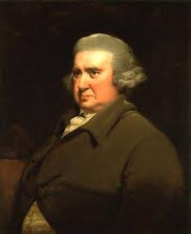
Occlusion therapy for amblyopia
Introduced to UK ophthalmology 300! yrs ago by Charles Darwin’s grandfather
Erasmus Darwin
1731 – 1802

Slide 51
1. What usually works: Opaque Occlusion
Occlusion Dose Monitor
Occlusion dose monitoring in amblyopia therapy:
status, insights, & future directions.
Stewart CE¹, Moseley MJ²,Georgiou P³, Fielder AR. J AAPOS Sept, 2017
Optometry & Visual Science, University of London, UK
Centre for Bio-inspired Technology, Electrical & Electronic Engineering, Imperial College London, UK
We are entering the era of personalized ophthalmology in which treatments will be tailored to the needs of the individual child and facilitated by the use of wearable monitors.

Slide 52
1. What usually works: Opaque Occlusion
Occlusion Dose Monitor

Slide 53
Dissenter #1: Bill Scott Iowa
MUCH more is always better
All patients : full-time occlusion
Success : 20/30 or better, or equal VA by ﬁxation pattern.
600 pts followed up after cessation of FT patching [mean 7y]. 89% followed > 1 y.
W Scott J AAPOS 2005

Slide 54
Scott: EXCEPTIONAL Results 1
96% attained “success”.
60%: equal visual acuity.
6/12 - 6/30 : 6/9 or ≥ 3 lines improvement:
PEDIG ~80%, Scott 96%

Slide 55
Scott: EXCEPTIONAL Results 2
Younger: less occlusion time to endpoint & better visual outcome (P = 0.0001).
Incidence of occlusion amblyopia was 26%. Nearly all treatable = price to pay for ?superior results
Unlikely to ever be tested against ‘newer’ lower dose treatments

Slide 56
OVERVIEW – TREATMENTS
2. What might work / sometimes works
Alignment surgery alone
Alignment surgery + patch/ atropine
Acupuncture
Magnetic brain stimulation
CNS Drugs
Liquid Xl glasses
Binocular sensory treatments

Slide 57
2. What might work / sometimes works: Alignment surgery
Alignment surgery alone: will fix amblyopia 25% of the time
Patch/ atropine after alignment surgery: no good studies. Often works better than before alignment surgery

Slide 58
2. What might work / sometimes works
Acupuncture : one study. Probably works. Very $
Magnetic brain stimulation: will never be studied in kids
CNS Drugs
Liquid Xl glasses

Slide 59
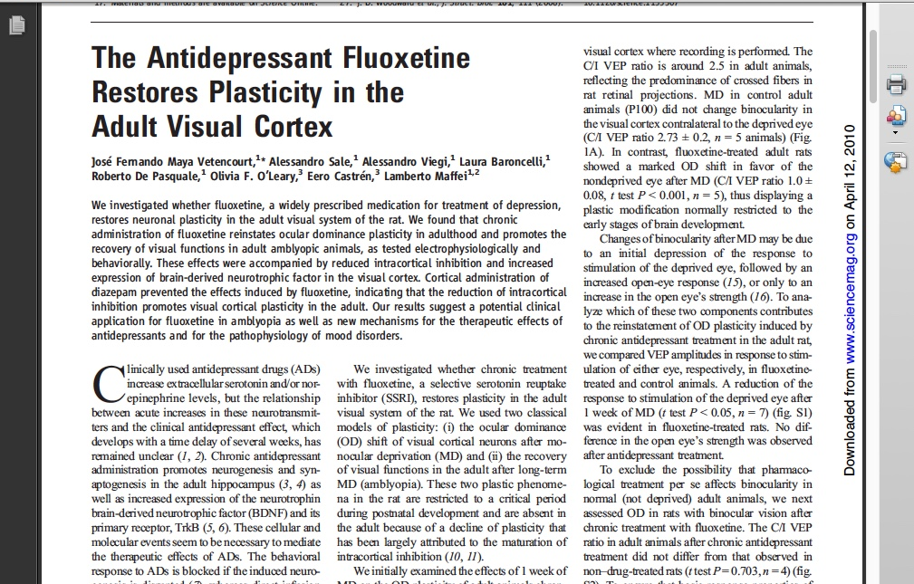
2. What might work / sometimes works CNS Drugs
SCIENCE VOL 320 18 APRIL 2008

Slide 60
CNS drugs:
L-Dopa
Archives Ophthal Sept 2010
On/off for 25 yrs for all-comers & stubborn amblyopia
Stubborn amblyopia
9 weeks of meds with 3h/d of patch
1/3: 2 line improvement that usually lasts

Slide 61
Liquid Xl glasses
Wang J, Neely DE, Galli J, Schliesser J, Graves A, Damarjian TG, et al.
A pilot randomized clinical trial of intermittent occlusion therapy liquid crystal glasses versus traditional patching for treatment of moderate unilateral amblyopia.
J AAPOS. 2016;20:326–31.

Slide 62
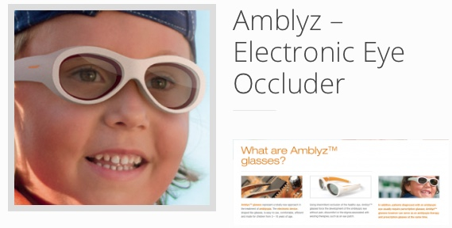
Liquid Xl glasses one lens darkens : one second on / off
Popular in Turkey: now
made by a competitor
Main problems: still ugly, expensive

Slide 63
2A. What might / sometimes work
BINOCULAR SENSORY TREATMENTS
Glasses – symmetrise sensory input
Translucent occlusion – Bangerter
Atropine
Optical penalisation
Video games

Slide 64

BINOCULAR SENSORY TREATMENTS
Videos & video games
Principle:
Different sensory inputs to each eye
High contrast image to amblyopic eye, lower contrast to normal eye
Can continually modify contrast as amblyopia improves
Hi-tech / sexy / appealing / very 21st century
Platforms:
IPad, IPod, virtual reality players,…

Slide 65
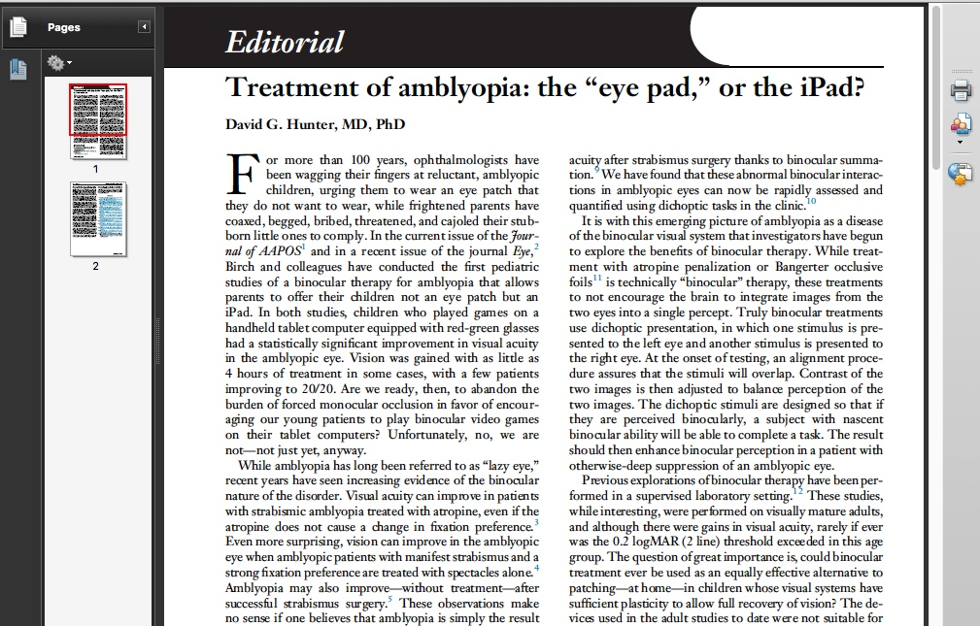
BINOCULAR SENSORY TREATMENTS
Videos & video games

Slide 66

BRAVO Tetris Amblyopia treatment - Rationale
Manipulate contrast differences between the eyes to allow for binocular viewing in amblyopia

Slide 67
Principle Applied to a Portable Device
To et al., (2011), IEEE Transactions on Neural Systems and Rehabilitation Engineering, 19, 280-289.
Notes:
8/10 improved acuity, 6/10 improved stereo acuity – 4 measureable stereo for the first time.

Slide 71
BRAVO
The Binocular Treatment of Amblyopia using Videogames (BRAVO) study: A Randomized Controlled Trial of a Binocular Videogame Treatment vs. Placebo.
Benjamin Thompson……on behalf of the BRAVO study team

Slide 72
Purpose: …presenting high contrast stimulus elements to the amblyopic eye and lower contrast elements to the fellow eye to overcome suppression and promote binocular function.
In this randomized trial, we compared a binocular treatment videogame with a placebo game in older children and adults with amblyopia.

Slide 73
Methods: Participants had strabismic, anisometropic or mixed amblyopia with amblyopic eye distance visual acuity (DVA) ≥ 0.30 log Minimum Angle of Resolution (MAR) and an interocular acuity difference ≥ 0.2 log MAR.
Recruitment : Auckland, Waterloo, Montreal, Melbourne and Hong Kong, and was stratified by age; 7-12 years, 13-17 years and 18+.
Participants randomized to 6 w (1 hour per day) of home-based treatment using an iPod-based, dichoptic, contrast balanced video game or a placebo game with no interocular contrast difference.
The game involved tessellating falling blocks.
The primary outcome was change in amblyopic eye visual acuity from baseline to 6 weeks.

Slide 74
Results: 115 participants were randomized, 56 to the active group and 59 to placebo.
An intention to treat analysis adjusted for baseline VA and age revealed a VA improvement of only 0.055 log MAR in the active group and 0.074 log MAR in the placebo group. The change in VA did not differ significantly between the groups (p = 0.25). There were no significant differences between the active and placebo groups for any of the secondary outcome variables.
75% of the active and 86% of the placebo group exceeded our pre-specified criterion for compliance at 6 weeks (>25% of prescribed dose; >10.5 hours of treatment).
The results did not change when age groups were analyzed separately or when patients with or without strabismus were considered separately.

Slide 75
BRAVO Conclusion
The active treatment did not induce a treatment effect in this study and therefore did not differ from the placebo control.
This result highlights the challenge of translating promising, laboratory-based results for binocular treatment into a home-based intervention.

Slide 76
LK personal observations
You need to test things well before they enter mainstream therapy
It’s VERY expensive in $ and resources to test things well
‘Failure’ has not dampened the enthusiasm of the researchers much
BRAVO could be tried on different models: eg ‘Pay per view’ online to encourage in-home discipline / compliance

Slide 77
NEW AMBLYOPIA TREATMENTS
Interesting developments waiting for real data
Vivid Vision
Shaw lenses

Slide 78
Vivid Vision
Interesting developments waiting for real data
Very interesting, makes sense, some effect in pilot studies. So was BRAVO
Not to be confused with a VEGF trial of the same name [Intravitreal Aflibercept Injection in Vision Impairment Due to DME]

Slide 79
Shaw spectacle lenses & contact lenses in anisometropia
Interesting developments waiting for real data
Aniseikonia unlikely to be present if anisometropia is axial
20+ yrs ago: pilot trial in my office using CL’s for failed anisometropic amblyopia : no detectable benefit [for a LOT of work]*
*thank you Kate Helfrich

Slide 80
OVERVIEW – TREATMENTS
4. Big knowledge gaps
Natural history – does it ever improve without treatment ?
LK: several anecdotal cases

Slide 81
Reading list
Eileen Birch
David Hunter
Robert Hess
MOTAS
PEDIG

Slide 82
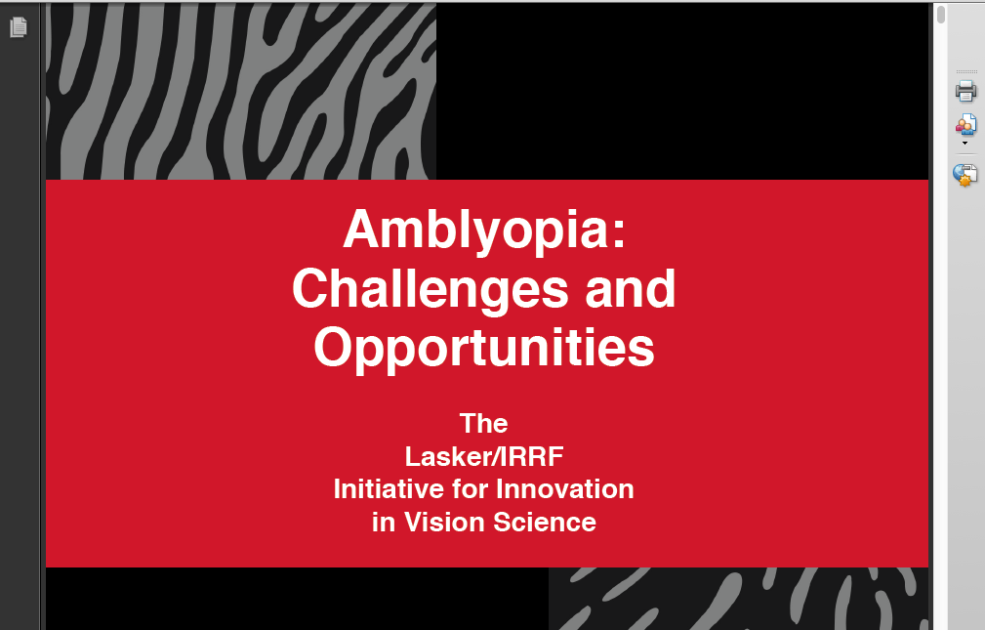

Slide 83
